Slide 1
Substation and Distribution Automation
Module 9: Automated Switching and Reconfiguration

Slide 2
Module 9 Overview
Part 1: Switching and protective devices
Part 2: Protection schemes
Part 3: Reconfiguration
Part 4: Switching examples

Slide 3
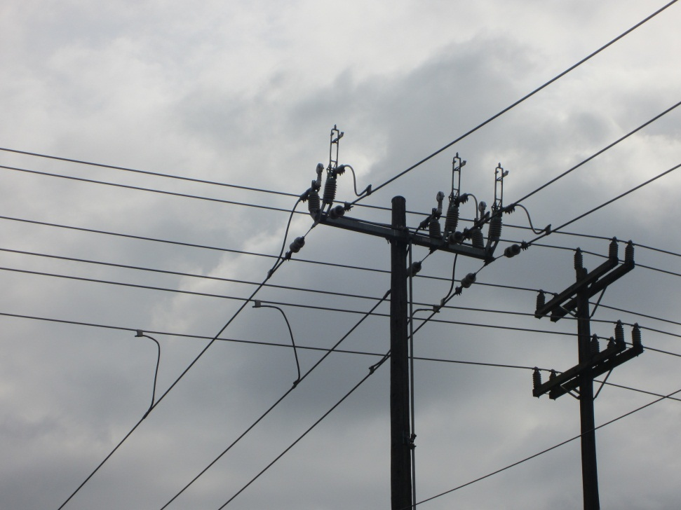
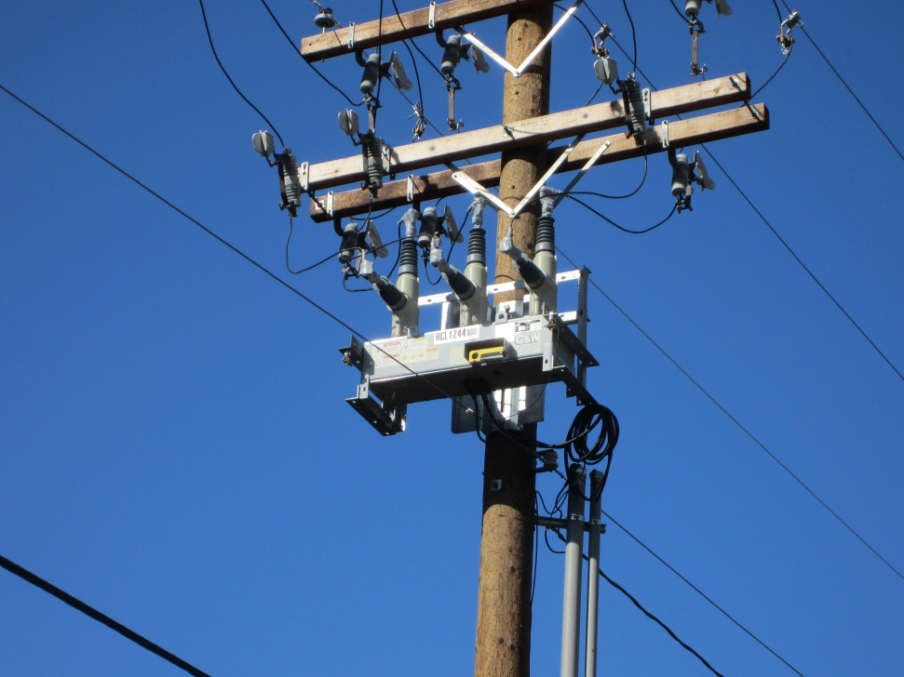
Part 1: Switching and Protective Devices

Slide 4
Switching and Protective Devices
Switches
Circuit Breakers
Fuses
Overcurrent Relays
Reclosers
Sectionalizers

Slide 5
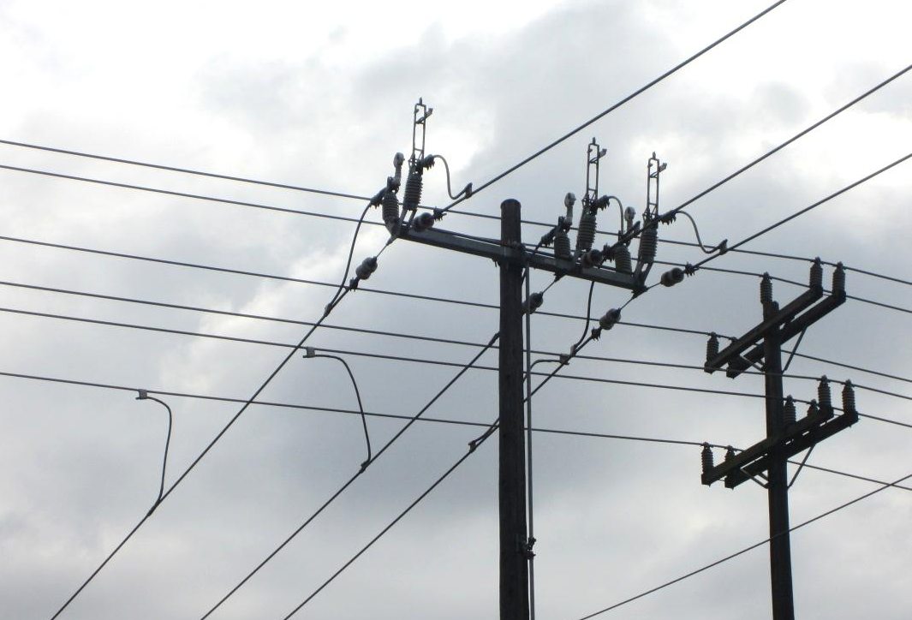
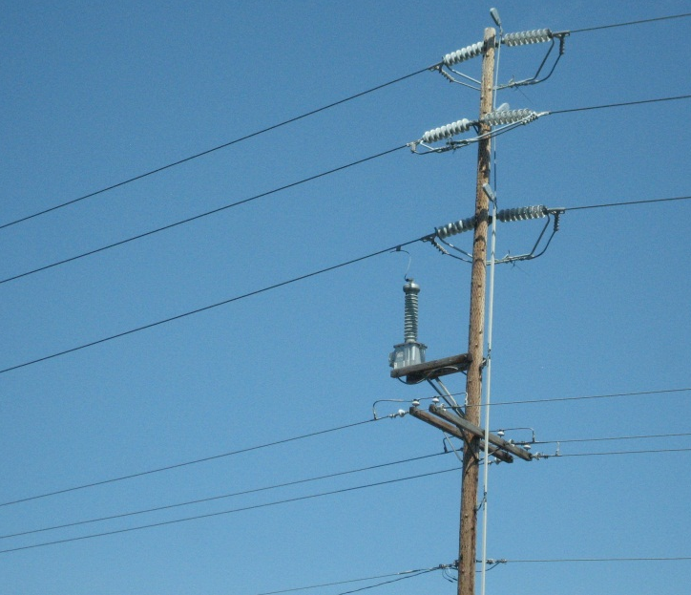
Switches
Switches are simple devices that typically do not have any controls or communication.
A switch can not break fault current.

Slide 6
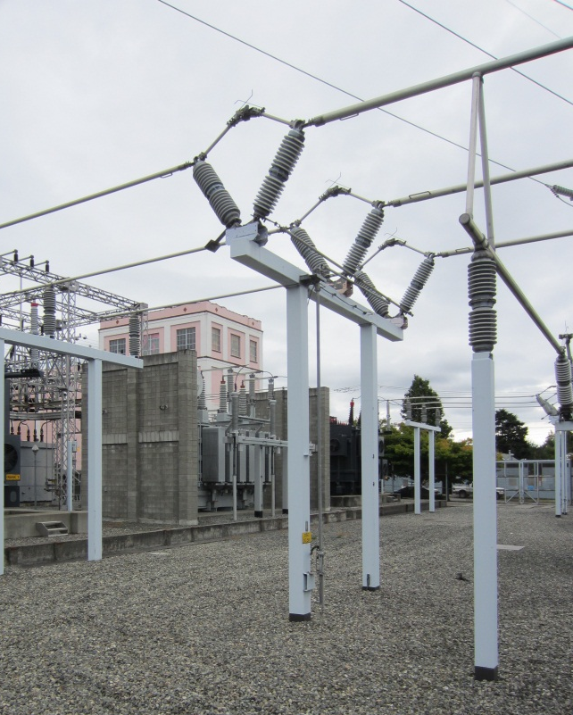
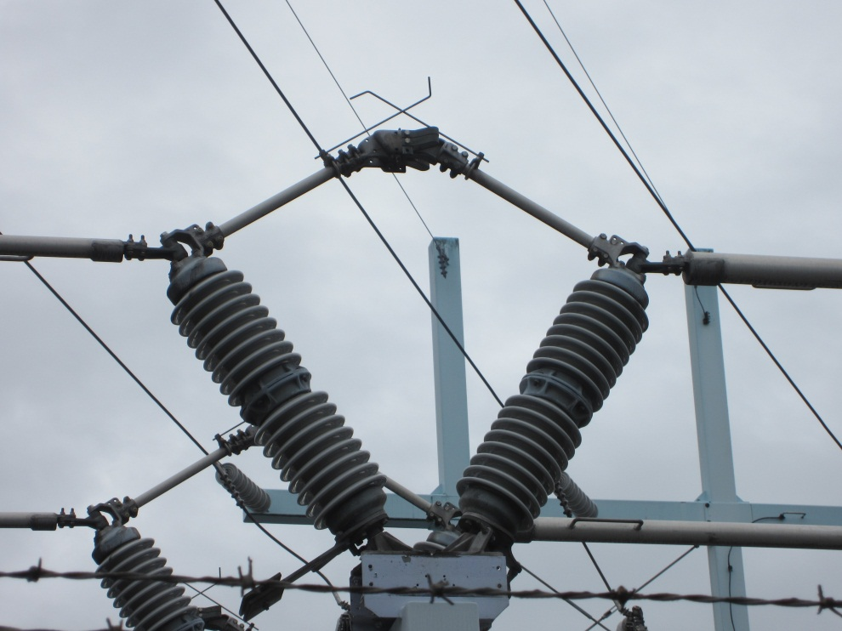
Switches
Used to:
Disconnect portions of a feeder or equipment
Reconfigure the feeder
Bypass portions of a feeder or equipment
Portions of the feeder or equipment may be disconnected and taken out of service for maintenance or repair.

Slide 7
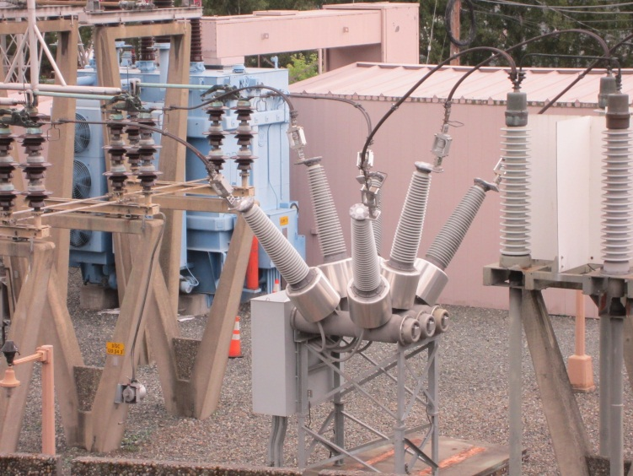
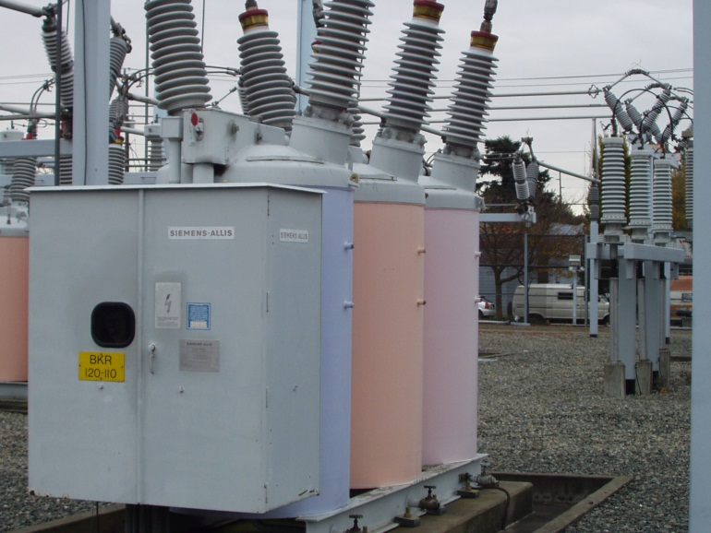
Circuit Breakers
Similar to switches, but have the ability to break fault current and work autonomously.
Do not need to be replaced like fuses and can generally be reset/closed.
Typically used for protection rather than a simple disconnect.
Older models don’t have communications or complex controls.

Slide 8
Circuit Breakers
Newer models have the option to have communications and more complex controls.
Given the ability to control remotely and provide feedback to the control center, circuit breakers are becoming more prevalent for feeder reconfiguration and as bypass components.

Slide 9
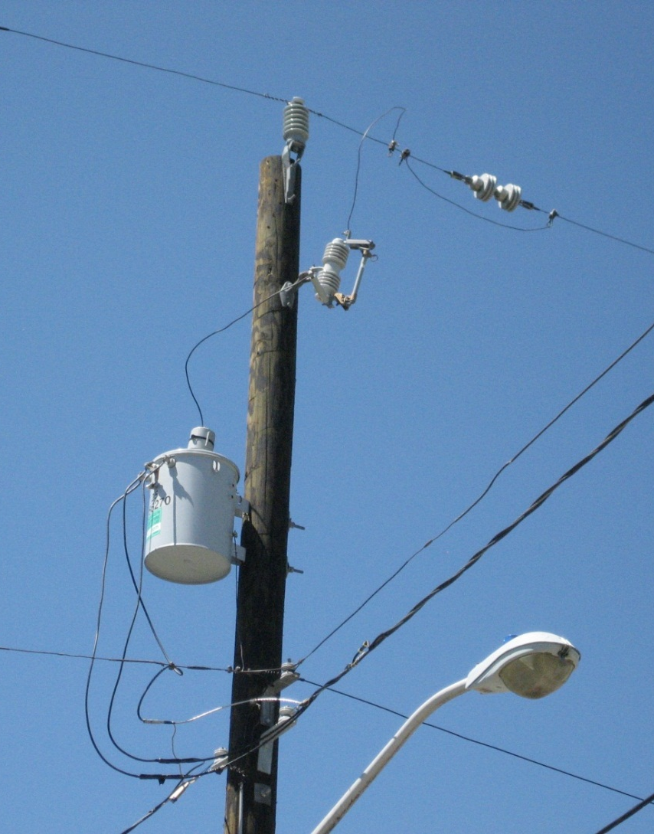
Fuses
Protection device used to break fault current.
Removes faulted sections of a feeder from the system.
Need to be manually replaced because the fuse sacrifices itself to protect the feeder and its components.
Fuse designed to ‘blow’ within specified time for given value of fault current.

Slide 10
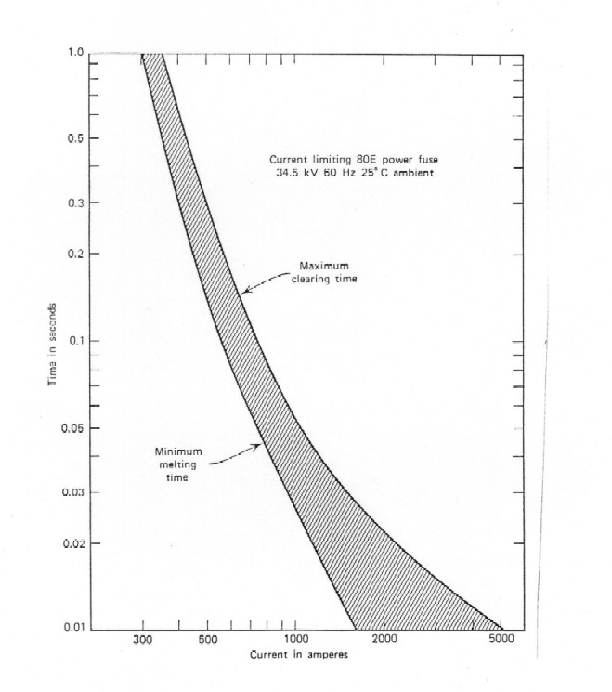
Fuses
Two types: expulsion and current limiting fuses
“Expulsion fuses use gas generation and exhaust to remove conducting particles from the arc column and allow the fuse to interrupt current at current zero”
“Current limiting fuses reduce the magnitude and duration of the fault current by introducing a high resistance into the circuit”
IEEE Guide for Protective Relay Applications to Distribution Lines, IEEE Std C37.230-2007

Slide 11
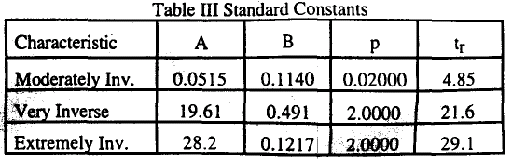
Overcurrent Relays
Overcurrent relays and fuses are the oldest, least expensive, and simplest
Overcurrent relay responds to current signals from sensors and operates a circuit breaker
Inverse time-current characteristic of relay according to IEEE standard¹ and power line used for real-time thermal rating²
(Extracted from ¹)
1: "IEEE standard inverse-time characteristic equations for overcurrent relays," IEEE Trans. on Power Delivery, Jul 1999.
2: M.W. Davis, "A new thermal rating approach: The real time thermal rating system for strategic overhead conductor transmission lines - Part I," IEEE Trans. on Power Apparatus and Systems, May 1977

Slide 12
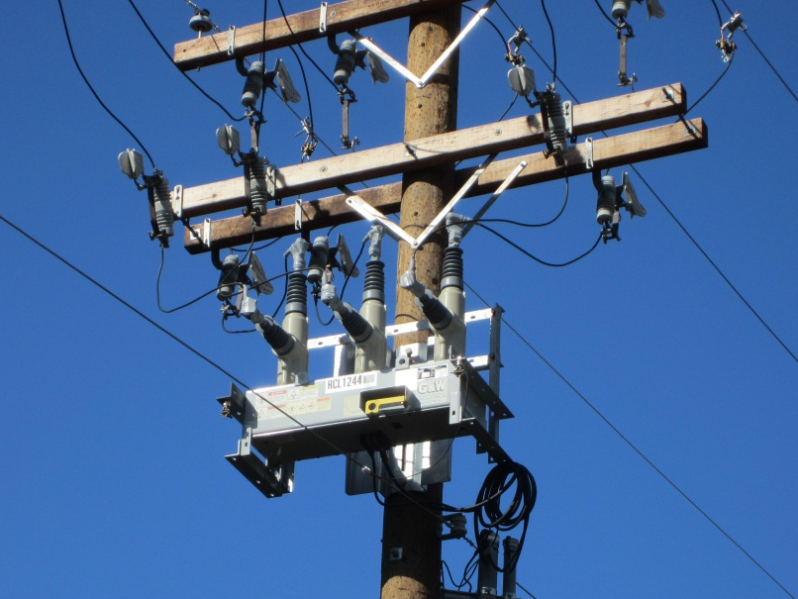
Reclosers
Similar to circuit breakers, but with more complex controls and the option for even more measurement and feedback.
Used for protection, especially for fault detection and disconnection.
Trips and recloses to clear temporary faults
The number of tries to reconnect is user configurable, but is typically set for three attempts.

Slide 13
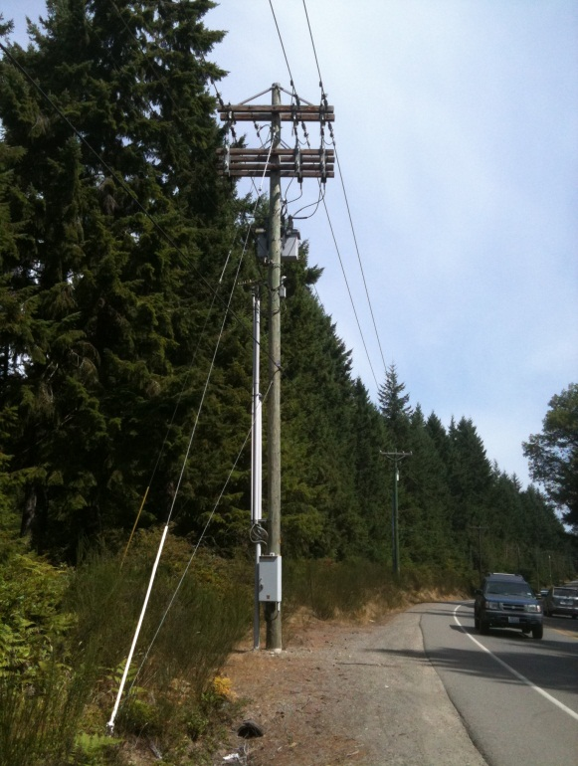
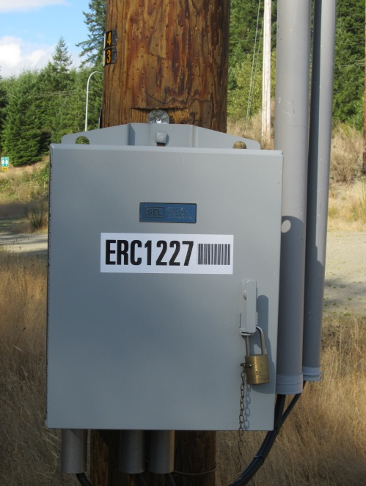
Reclosers
With the development of the Smart Grid, reclosers are starting to incorporate more advanced metering and reporting capabilities.

Slide 14
Reclosers
Combines the sensing, relaying, fault-interrupting, and reclosing functions
Placed in substations or out on the distribution lines
Modes of operation:
single-phase trip
single-phase lockout
single-phase trip three-phase lockout
three-phase trip three-phase lockout
Figures of reclose characteristics (from standard?)
Example of reclosing times (from book)

Slide 15
Sectionalizers
Similar to circuit breakers, but can not break fault current and have more complex controls.
Used in conjunction with a recloser.
The recloser breaks the fault current, the sectionalizer disconnects the faulted section from the feeder and the recloser reconnects the rest of the feeder to power.
With the development of the Smart Grid, sectionalizers are starting to incorporate more advanced metering and reporting capabilities.

Slide 16
Part 2: Protection Schemes
The individual protection devices in the previous section can be combined into various protection schemes.
When the power flow is radial then the schemes are relatively simple, but bidirectional power flows can complicate protection schemes.

Slide 17
Overcurrent schemes
Three types
Phase overcurrent
Ground overcurrent
Negative sequence overcurrent
Non-directional relay applied to radial distribution systems (one direction power flow)
Directional relay applied to network or looped system
IEEE Guide for Protective Relay Applications to Distribution Lines, IEEE Std C37.230-2007

Slide 18
Coordination of Protection Schemes
Fault current calculation
Balanced faults: short-circuit calculation considering contribution of all resources
Unbalanced faults: short-circuit calculation using symmetrical components methods
Coordination of protection schemes considers
Intensity of fault currents
Direction of fault currents
Definition of primary protection and backup protections

Slide 19
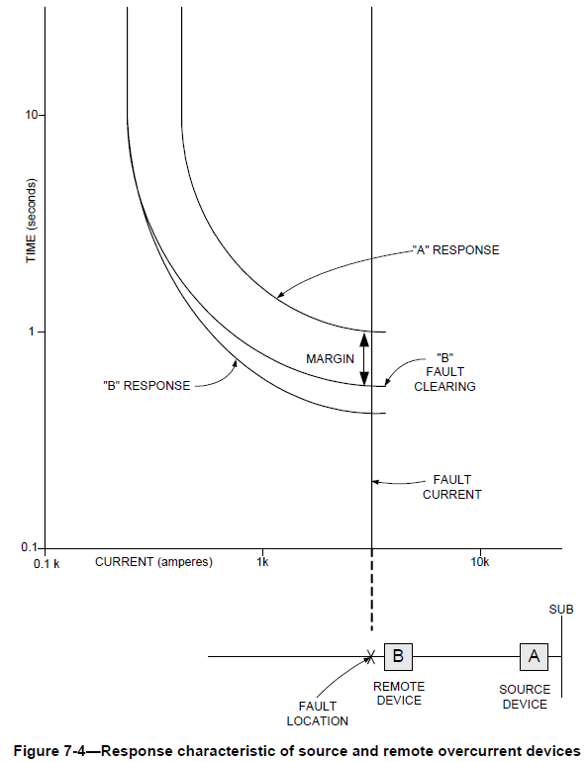
Coordination Schemes in Radial Network
Two overcurrent devices
IEEE Guide for Protective Relay Applications to Distribution Lines, IEEE Std C37.230-2007

Slide 20
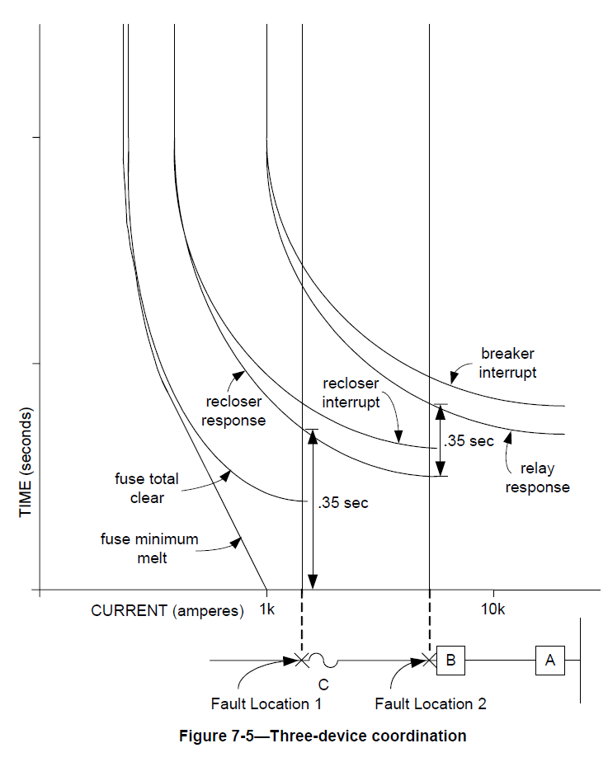
Coordination Schemes in Radial Network
Fuse, recloser, and overcurrent relay
IEEE Guide for Protective Relay Applications to Distribution Lines, IEEE Std C37.230-2007

Slide 21
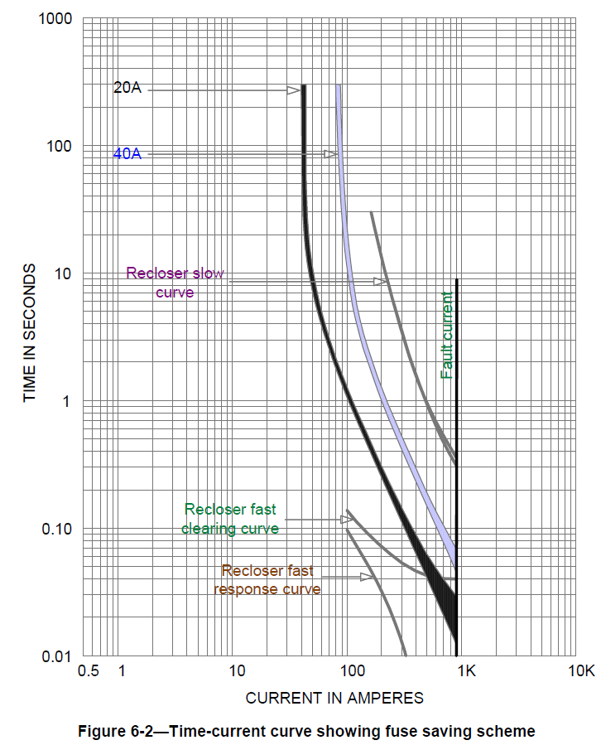
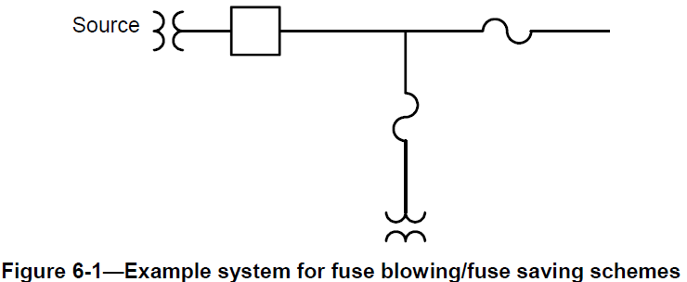
Coordination Schemes in Radial Network
Recloser and fuses
Fuse saving scheme
IEEE Guide for Protective Relay Applications to Distribution Lines, IEEE Std C37.230-2007

Slide 22
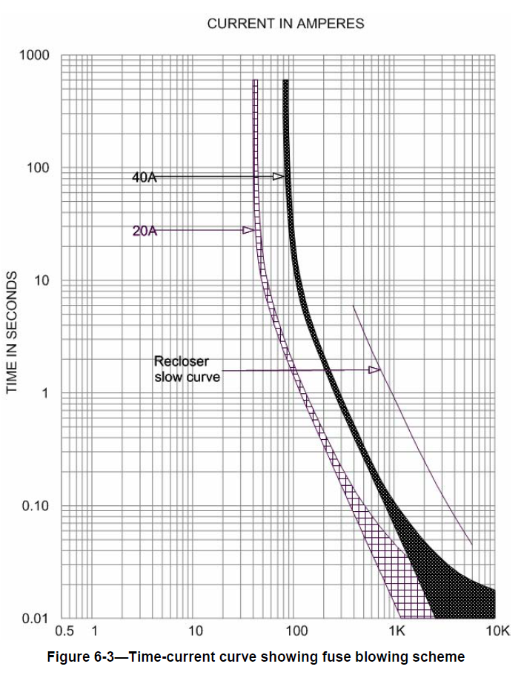
Coordination Schemes in Radial Network
Recloser and fuses
Fuse blowing scheme
IEEE Guide for Protective Relay Applications to Distribution Lines, IEEE Std C37.230-2007

Slide 23
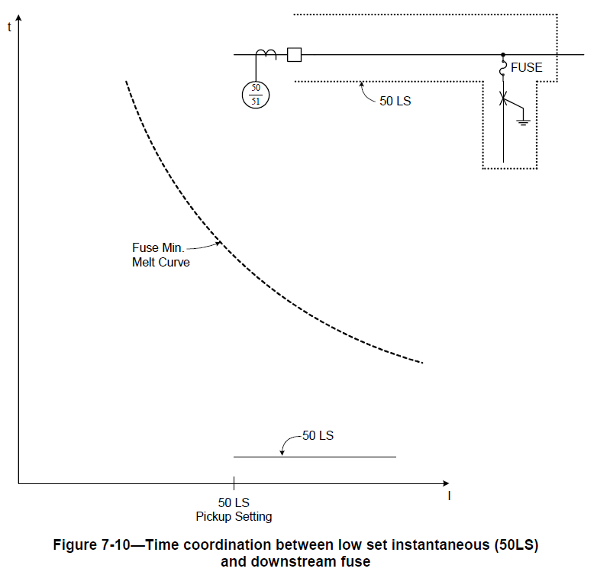
Coordination Schemes in Radial Network
Fuse saving
Low set instantaneous relay 50LS trips for any faults on the entire feeder
For a permanent fault, after 2 or 3 reclosing attempts, the relay is blocked and the fuse is allowed to blow
For temporary faults the fuse will be saved
IEEE Guide for Protective Relay Applications to Distribution Lines, IEEE Std C37.230-2007

Slide 24
Voltage Scheme
Voltage sensing relay applications:
“protect equipment (e.g., power transformers) from damage”
“determine if a supply source is healthy or not (i.e., source transfer schemes)”
“detect ground faults on normally ungrounded systems”
“supervise automatic or manual closing of circuit breakers”
“determine whether a single breaker pole is open or closed undesirably”
“detect unbalanced voltage due to a blown fuse”
“supervise or restrain overcurrent elements for fault detection near generation sources”
Over- and under-voltage sensing
Phase-to-phase and phase-to-ground sensing
IEEE Guide for Protective Relay Applications to Distribution Lines, IEEE Std C37.230-2007

Slide 25
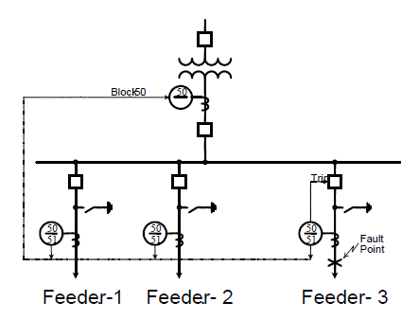
Overcurrent Protection Schemes
Most common protection scheme in distribution substations is over current protection for prevention against feeder faults.
The figure shows the co-ordination between different instantaneous tripping elements in the substation.

Slide 26
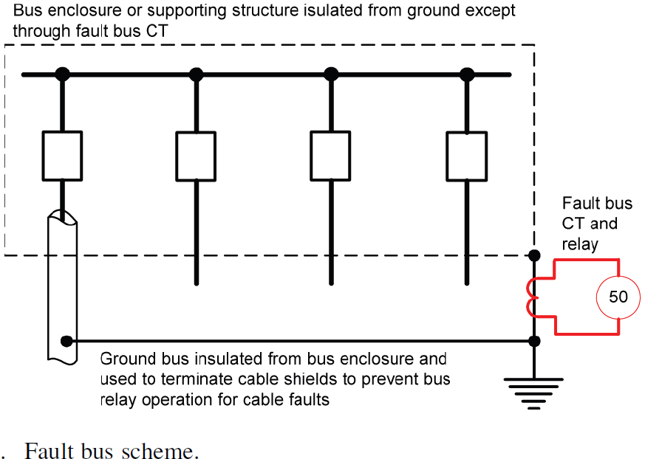
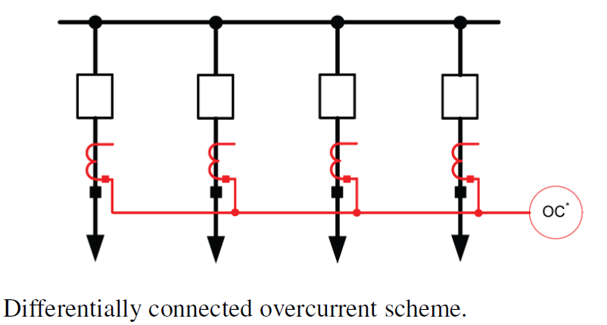
Bus Differential
"Exploring the IEEE C37.234 Guide for Protective Relay Application to Power System Buses," Annual Conference for Protective Relay Engineers, April 2011

Slide 27
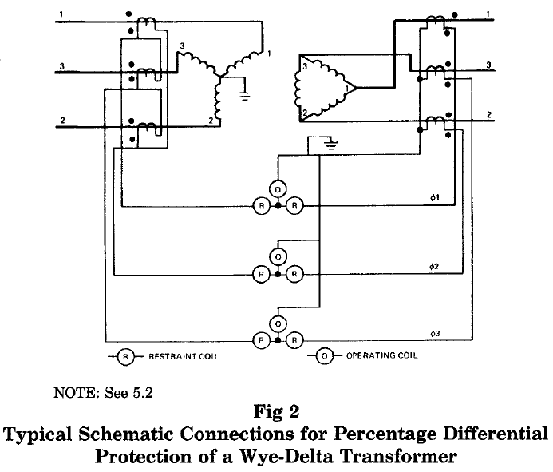
Transformer Differential
Most commonly applied for 10MVA transformer and higher
IEEE Guide for Protective Relay Applications to Power Transformers," ANSI/IEEE Std C37.91-1985

Slide 28
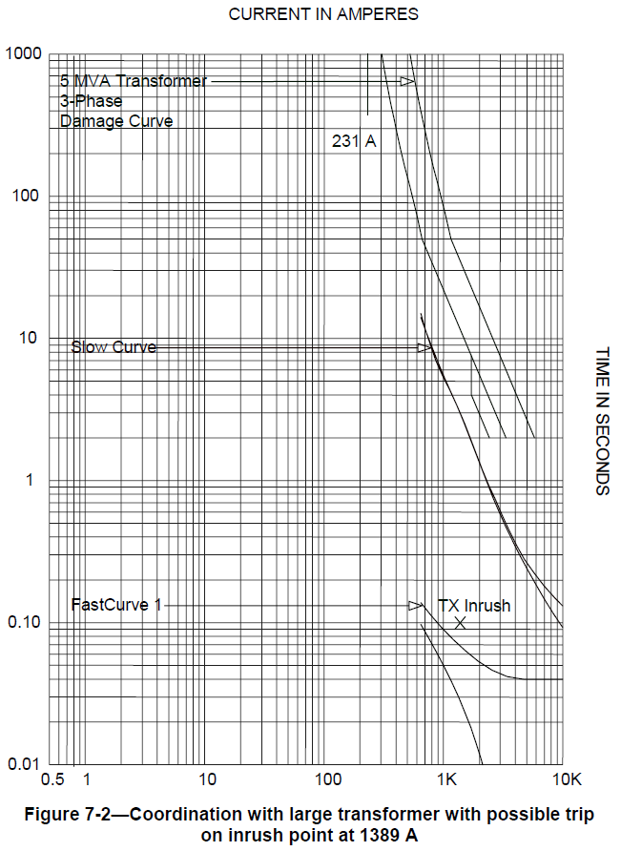
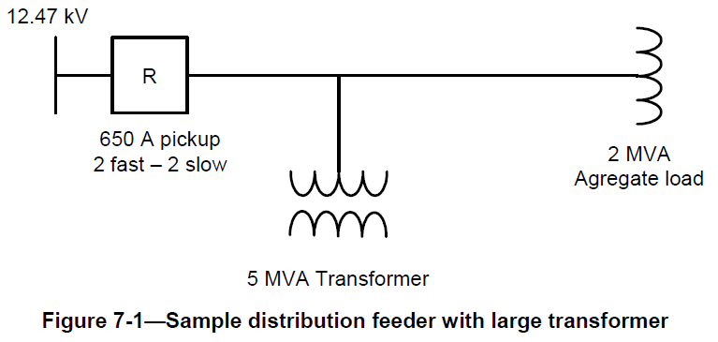
Coordination of Recloser and Large Transformer
Coordination of fast curve and slow curves of recloser with transformer damage curve and inrush current
IEEE Guide for Protective Relay Applications to Distribution Lines, IEEE Std C37.230-2007

Slide 29
Zone Protection
…

Slide 30
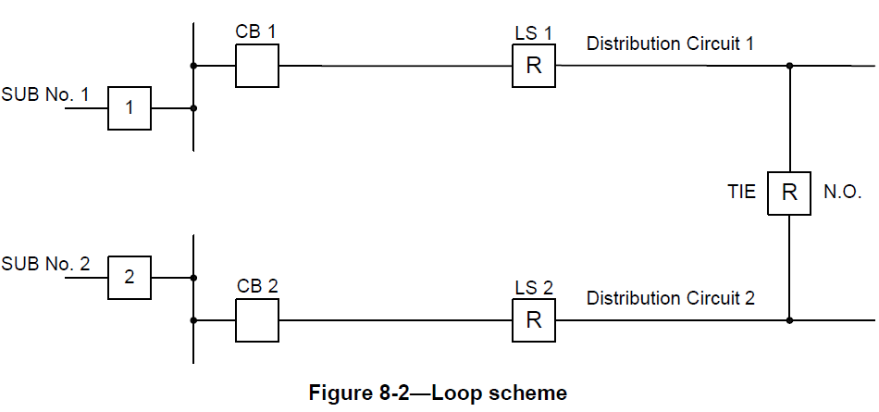
Loop Scheme
Normally open (N.O.) recloser between two circuits
Normally closed sectionalizing recloser on each circuit
Example of operation:
CB1 (circuit breaker 1) opens for a fault between devices CB1 and LS1.
LS1 sense a loss of voltage and opens
TIE recloser also sense loss of voltage, and close after the LS1 opens,
Automatically restoration of portion of Distribution Circuit 1.
Note: protection settings at the SUB Main Breaker and at the CB and LS should be set to account for the maximum load added when the tie recloser closes
IEEE Guide for Protective Relay Applications to Distribution Lines, IEEE Std C37.230-2007

Slide 31
Protection Coordination in Meshed Circuits
Radial circuits
Prot relaying.
Meshed circuits and bidirectional power flow

Slide 32
Directional Overcurrent Relays
Look for bibliography

Slide 33
Protection Schemes for Bidirectional Power Flow
Bidirectional power flows occur when there distributed resources contribute are allowed to contribute to fault current

Slide 34
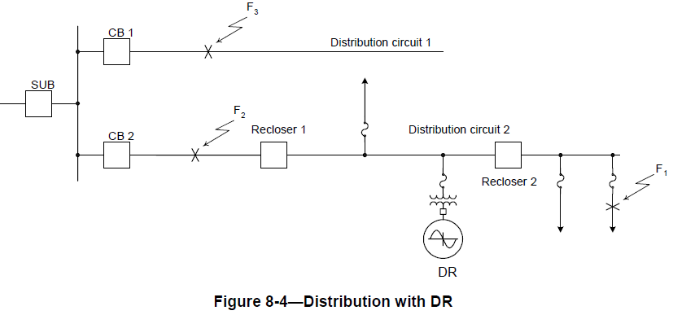
Protection Schemes with Distributed Resources
Fault F2 will cause reverse current through recloser 1. One solution is to coordinate DR protection with Recloser 1 to trip DR before Recloser 1 operates
Fault F3 causes reverse current in CB2. If CB2 is not coordinated with CB1 => unnecessary trip of circuit 2
IEEE Guide for Protective Relay Applications to Distribution Lines, IEEE Std C37.230-2007

Slide 35
Part 3: Reconfiguration
Changes in topology of the distribution network to achieve one of the following objectives
Minimize losses
Reduce losses and relieve line overloads
Improve voltage stability
Reduce losses and improve the voltage profile
Restore portions of a feeder by routing around a fault

Slide 36
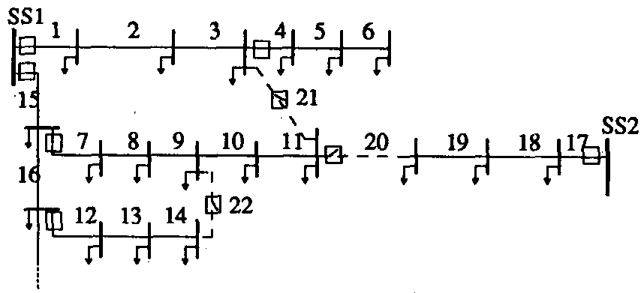
Radial Reconfiguration Problem
Switches are opened and closed to reconfigure the circuit, maintaining radial configuration
Example: close switch 21 and open switch 7 (radial structure is maintained). More combinations are possible.
Objectives: load reduction and relieve line overloads
Optimization problem: Find “spanning tree” that minimizes an objective function, while satisfying voltage constraints, capacity constraints, and reliability constraints
Combinatorial optimization
1,2,…, 22: branches
SS1, SS2: substations
: switch
: load
Solid lines: base radial configuration
Dashed lines: lines with open switches
M.E. Baran and F.F. Wu, "Network reconfiguration in distribution systems for loss reduction and load balancing," IEEE Transactions on Power Delivery, April 1989

Slide 37
Solution of Reconfiguration Problem
Combinatorial nonlinear problem
Heuristic solutions:
Branch exchanges ¹
Fuzzy multi-objective approach incorporating heuristic rules²
Evolutionary algorithms:
Variable scaling hybrid differential evolution, hybrid differential evolution, genetic algorithms, and simulated annealing³
Switches modeled as adjustable current sources⁴: iterative process where switch with lowest adjusted current is open until radial configuration is achieved
¹ : M. Baran, F. Wu, "Network reconfiguration in distribution systems for loss reduction and load balancing," IEEE Trans. Power Delivery, 1989
² : Das, D.; , "A fuzzy multiobjective approach for network reconfiguration of distribution systems," IEEE Trans. on Power Delivery, 2006
³ : Ji-Pyng Chiou, Chung-Fu Chang, Ching-Tzong Su "Variable scaling hybrid differential evolution for solving network reconfiguration of distribution systems," IEEE Trans. on Power Systems, 2005
⁴ : D. Shirmohammadi, H. Hong, "Reconfiguration of electric distribution networks for resistive line losses reduction," IEEE Trans. on Power Delivery, 1989

Slide 38
Part 4: Switching Examples

Slide 39
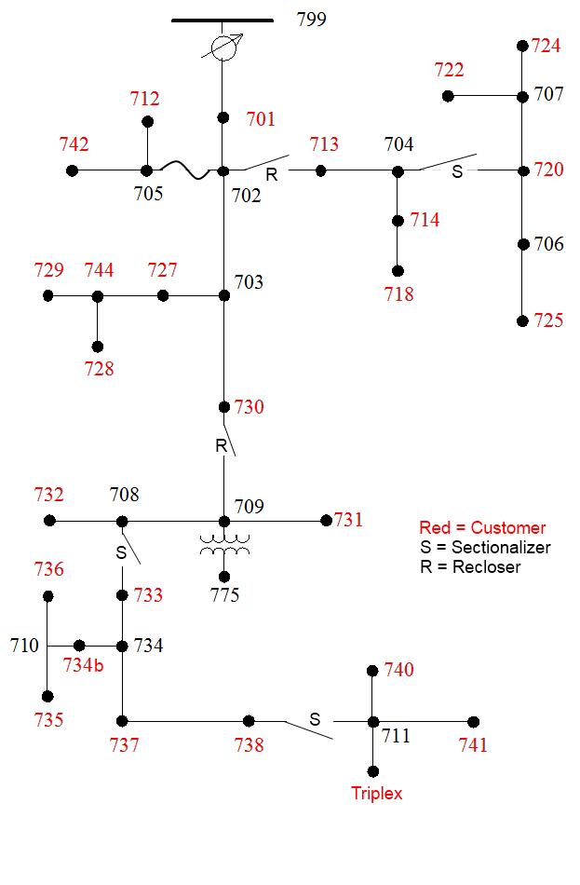
Example Scenario 1
Fault on line 711-741
The recloser between nodes 730 and 709 opens.
The sectionalizer between nodes 738 and 711 opens and disconnects the fault.
The sectionalizer between nodes 708 and 733 remains closed as it delays long enough to let the downstream sectionalizer open first.
The recloser closes and the fault is disconnected from the system.
IEEE 37 Node

Slide 40
Example Scenario 2
Fault on line 710-735
The recloser between nodes 730 and 709 opens.
The sectionalizer between nodes 708 and 733 remains closed as it delays long enough to let the downstream sectionalizer open first.
The sectionalizer between nodes 738 and 711 does not open as it does not sense fault current.
The recloser closes, but there is still a fault and opens again.
The sectionalizer between nodes 708 and 733 opens and disconnects the fault.
The recloser closes and the fault is disconnected from the system.
IEEE 37 Node

Slide 41
Example Scenario 3
Fault on line 775-709
Assume no protection on the transformer.
The recloser between nodes 730 and 709 opens.
The recloser closes, but there is still a fault and opens again.
The recloser closes, but there is still a fault and opens again.
The recloser closes, but there is still a fault and stays open. The recloser has now disconnected the fault from the system.
IEEE 37 Node

Slide 42
Example Scenario 4
Fault on line 705-712
The fuse between nodes 702 and 705 blows and removes the fault from the system.
IEEE 37 Node

Slide 43
Example Scenario Solutions
For Example Scenarios 1-3, a crew is dispatched to clear the fault.
The protective devices are reset either remotely or locally.
In Example Scenario 4, a crew is dispatched to clear the fault
The fuse is replaced.

Slide 44
Substation and Distribution Automation
Conclusion of Module 9: Automated Switching and Reconfiguration

